Slide 1
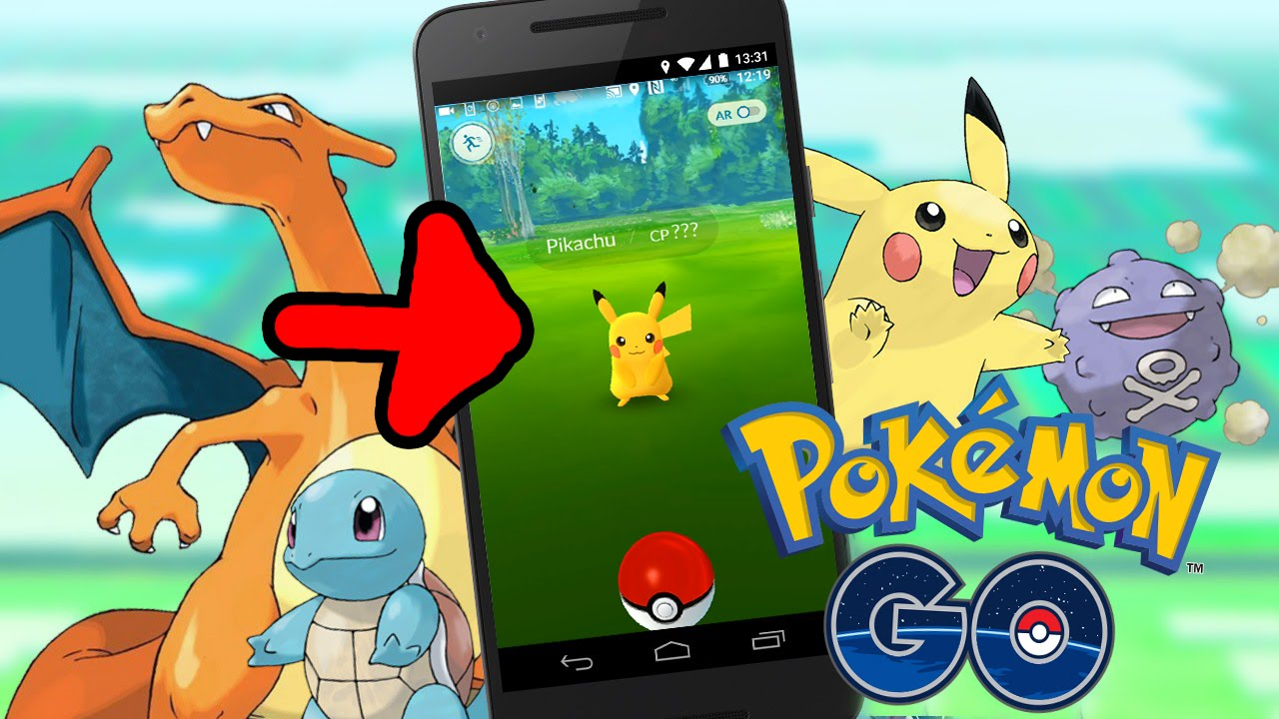
Time constrained maximal resource collecting problem - Pokemon Go
R78051012 蕭維慶
collect your level-up resources wisely

Slide 2
Process
Introduction
Previous Investigation
Method
Result
Conclusion

Slide 3
Introduction

Slide 4
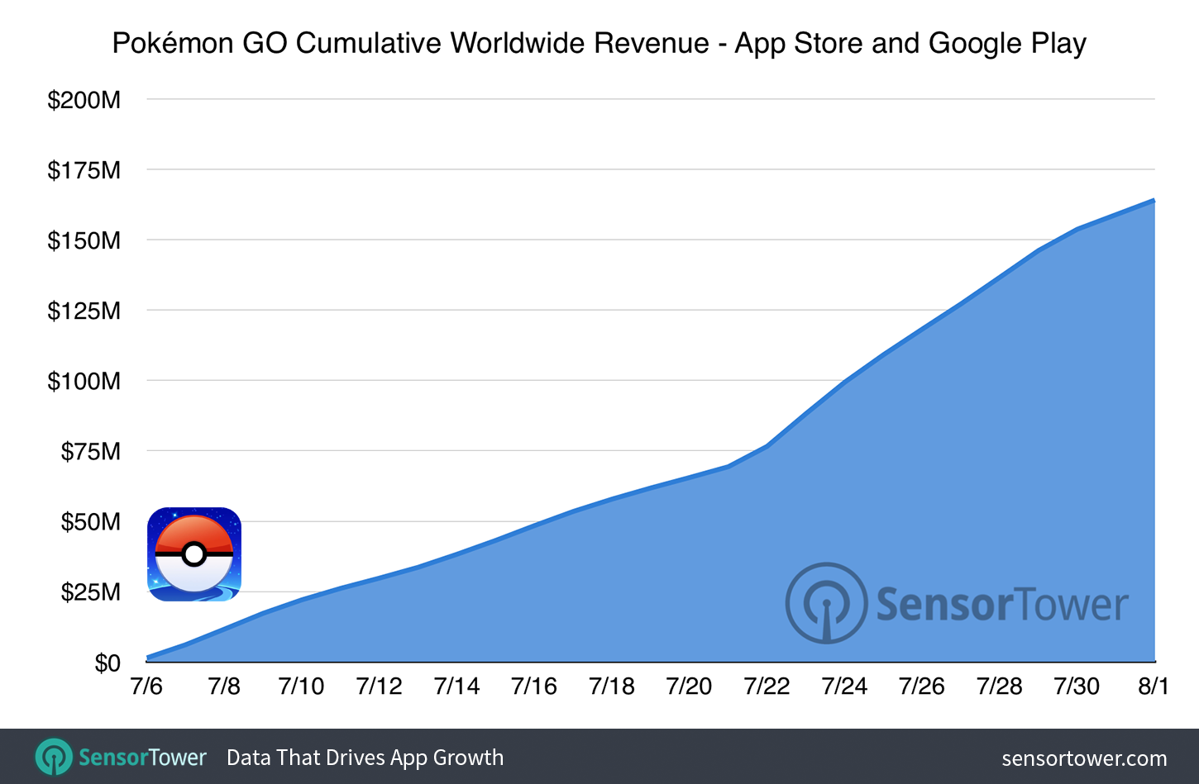

Slide 5
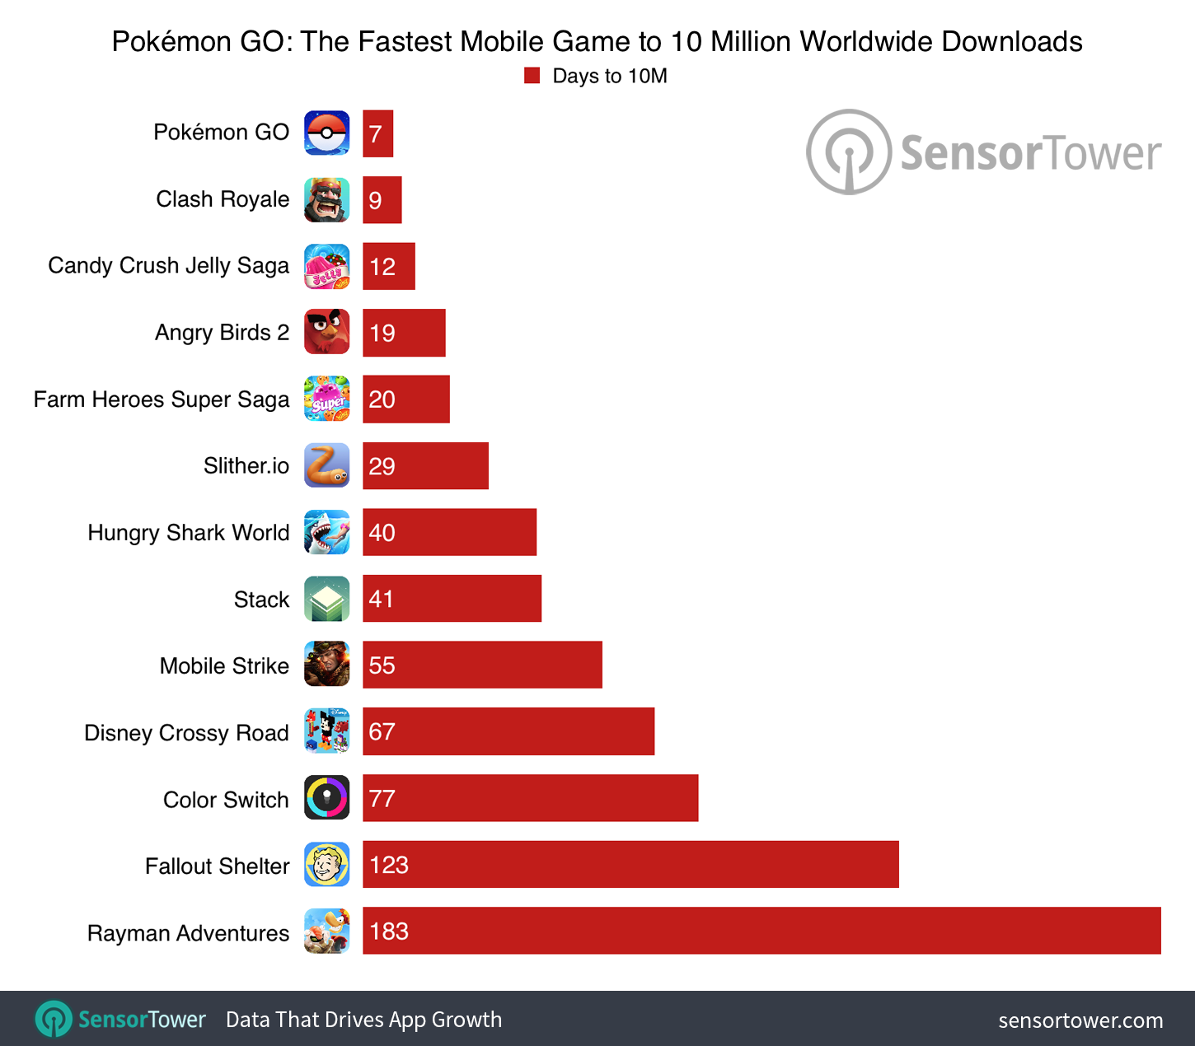

Slide 6
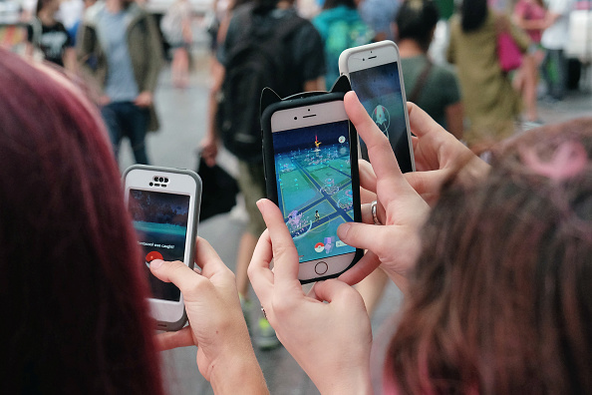
In busy life, spend time on Pokemon Go wisely and efficiently.
How to collect much more resource in time constratined

Slide 7
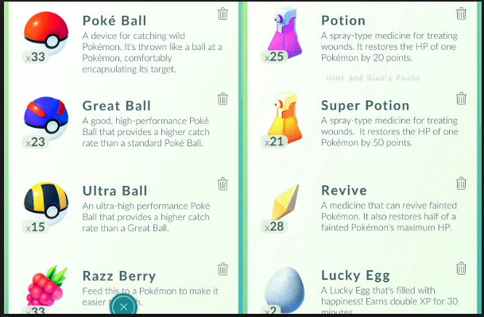
Pokemon Go 有許多種不同的物資

Slide 8
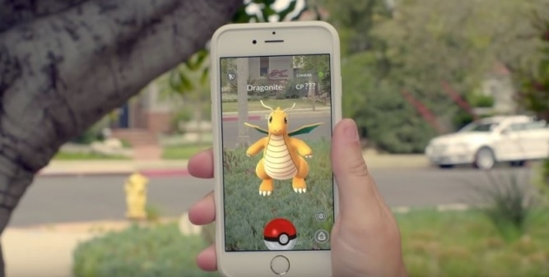
面對稀有怪獸，時常出現物資不足的情況

Slide 9
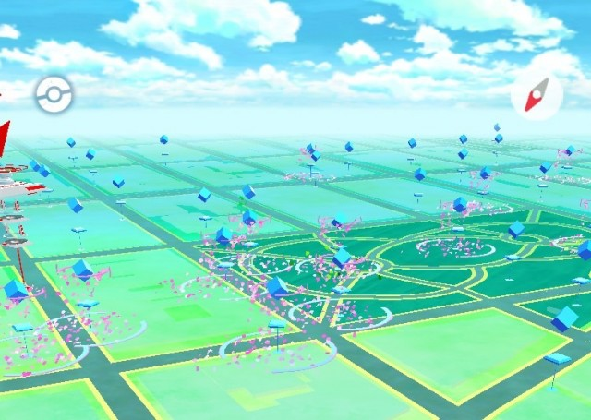
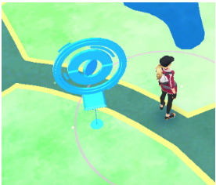
物資的取得來自於地圖上的補給站(藍色)

Slide 10
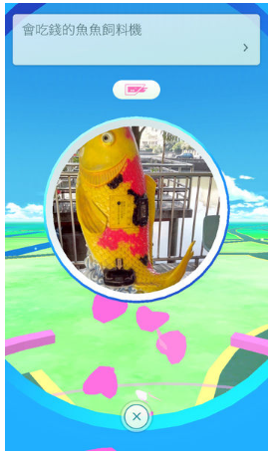
點擊補給站之後會出現詳細資訊

Slide 11
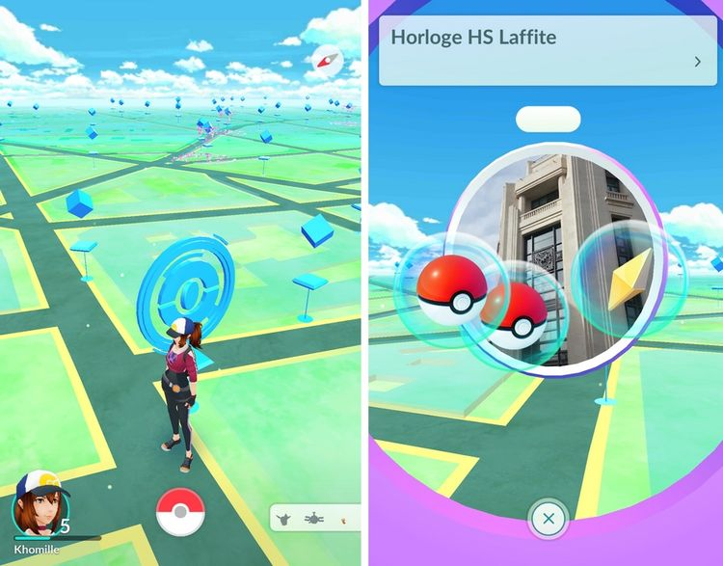
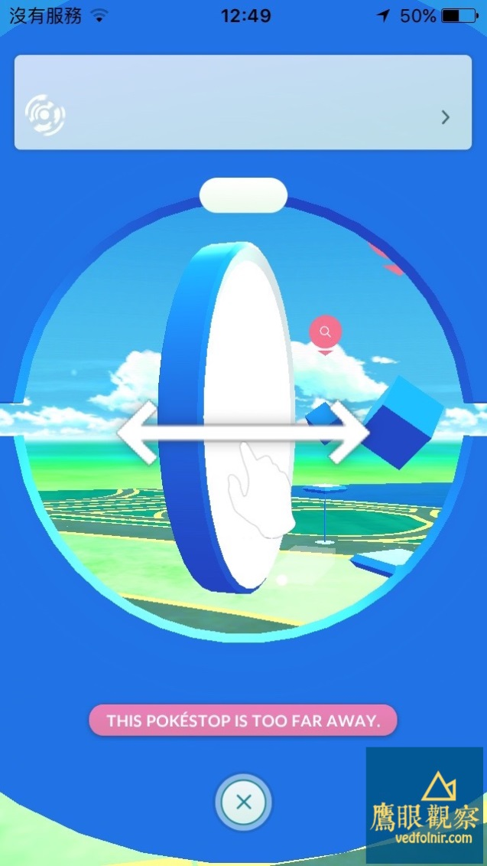
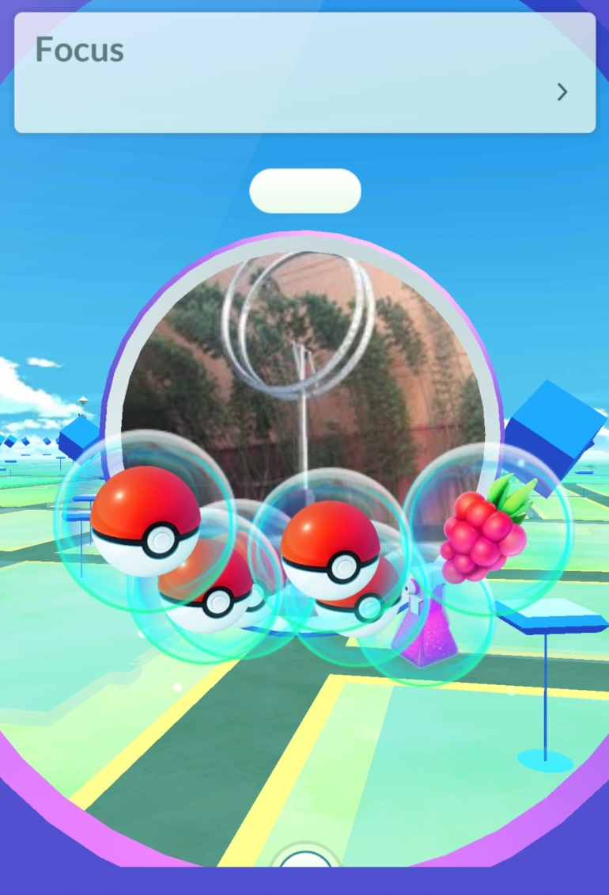
滑動補給站後會掉出資源

Slide 12
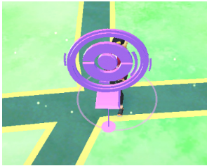
接著補給站變成紫色，五分鐘後刷新才能再次取得資源

Slide 14
Previous Investigation

Slide 15
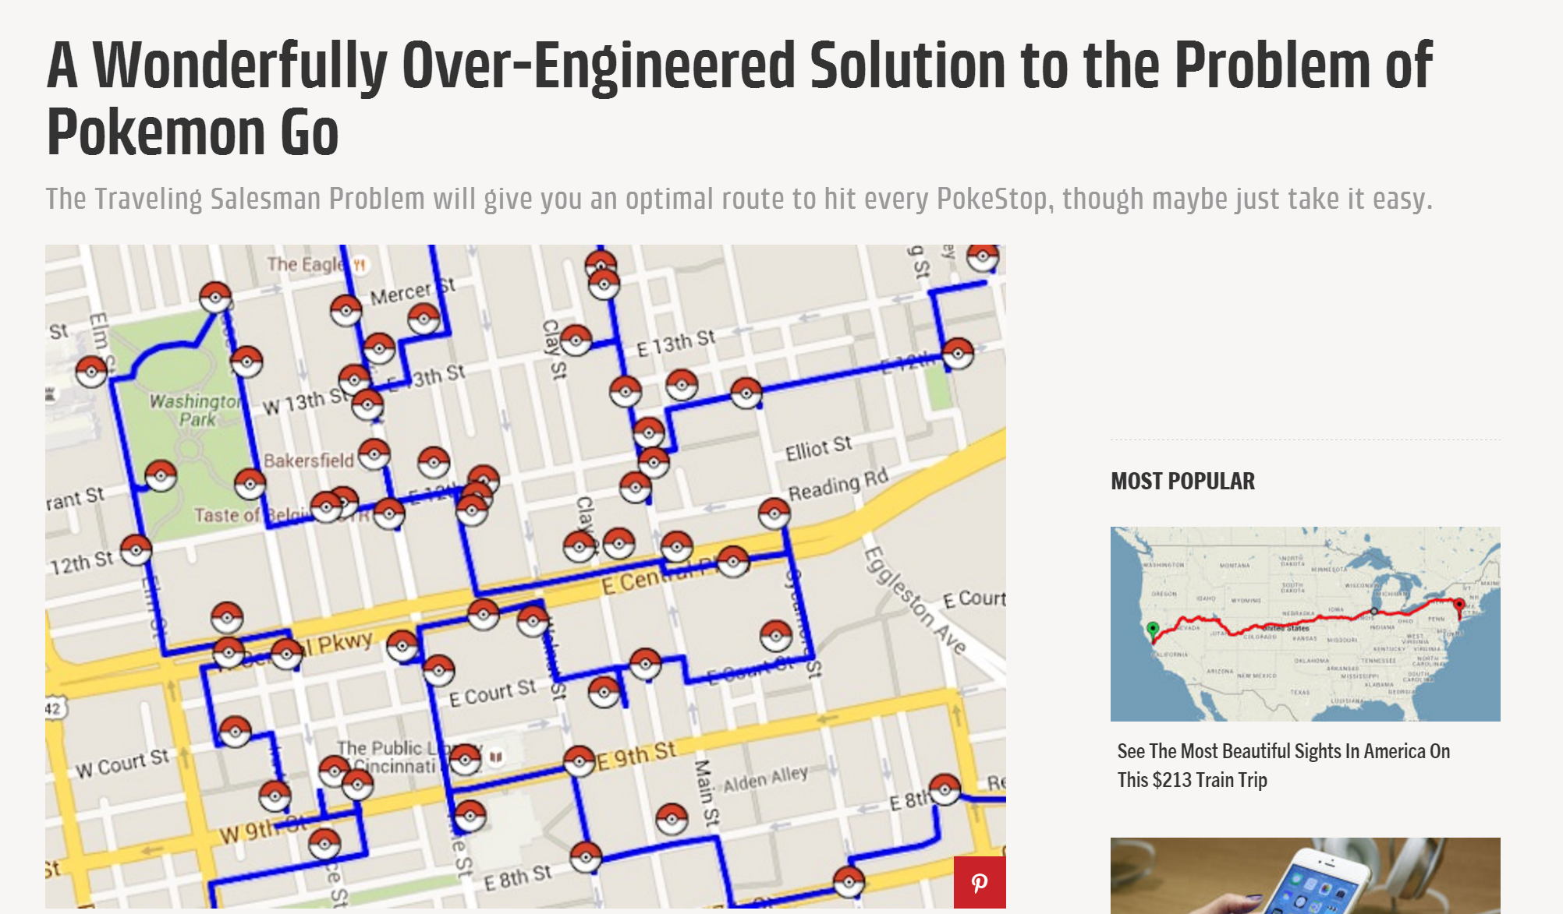
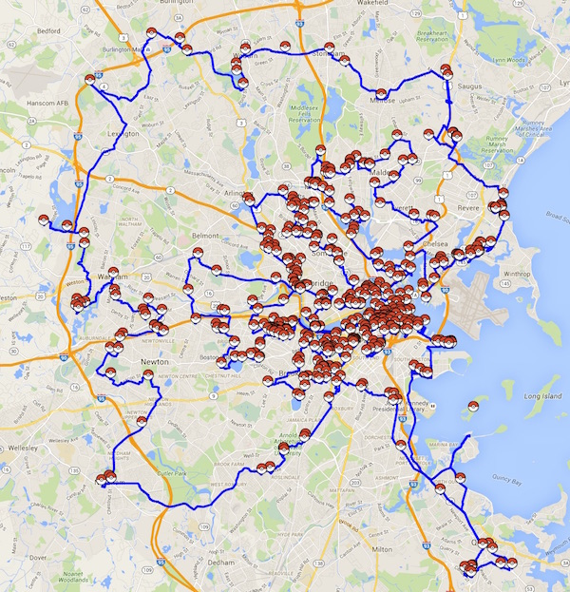
July 2016
Source: University of Waterloo

Slide 16
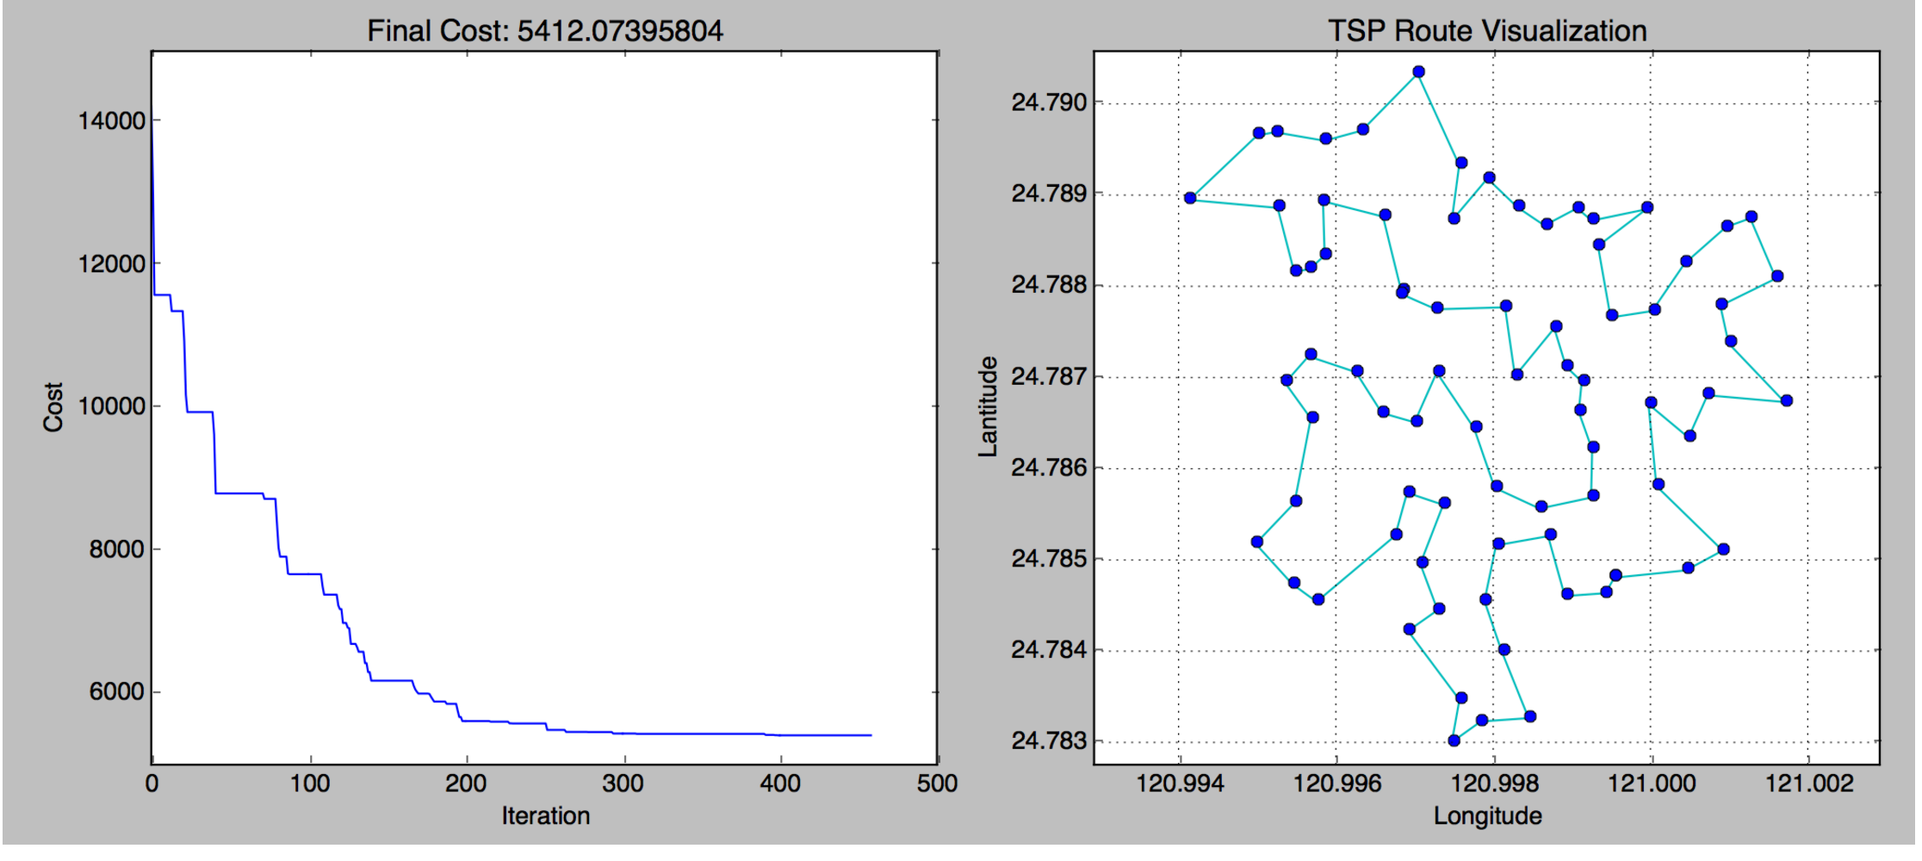
Simulated Annealing(SA) + Travelling salesman problem (TSP)

Slide 17
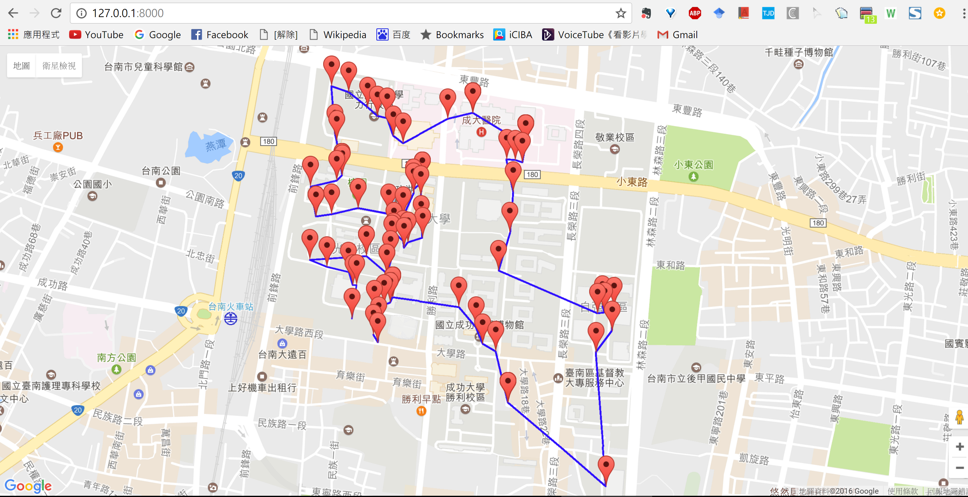

Slide 18
Research Method

Slide 19
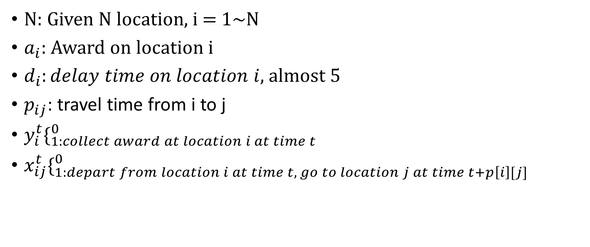
Notation
N: Given N location, i = 1~N
$a_{i}$: Award on location i
$d_{i}:delay time on location i$, almost 5
$p_{ij}$: travel time from i to j
$y_{i}^{t}\{_{1:collect award at location i at time t}^{0}$
$x_{ij}^{t}\{_{1:depart from location i at time t, go to location j at time t+p\left[i\right][j]}^{0}$

Slide 20

Objective
Maximal resource routing path in time
$\sum_{i}{\sum_{t}{a_{i}y_{i}^{t}}}$
Time space
t = 0 | t = 1 | t = 2 | t = 3 | t = 4
0 | 0 | 0 | 0 | 0
1 | 1 | 1 | 1 | 1
2 | 2 | 2 | 2 | 2
3 | 3 | 3 | 3 | 3
4 | 4 | 4 | 4 | 4
location

Slide 21

s.t(1)
$\sum_{jεN}{x_{ji}^{t+p\left[i\right][j]}−\sum_{jεN}{x_{ij}^{t}}=0 ∀}$I,t
Flow conservation
$\sum_{i∈N\backslash 0}{x_{0i}^{0}}$ = 1
Start from location 0 at time 0
$\sum_{i∈N\backslash 0}{x_{i0}^{T}}$ = 1
End to location 0 at time T

Slide 22
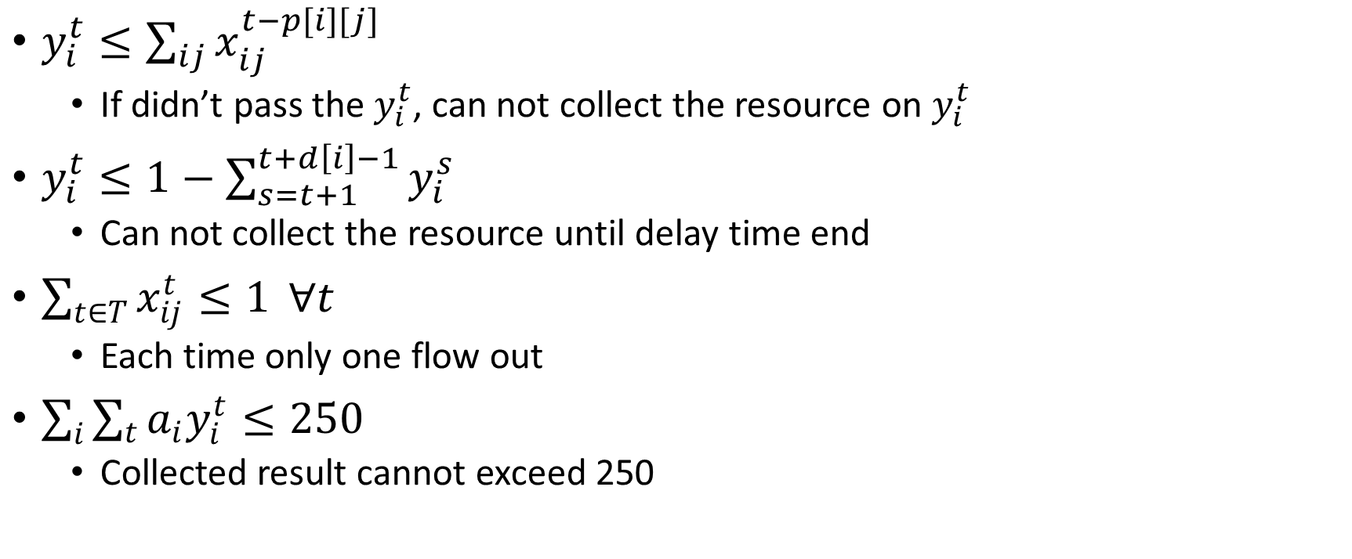
s.t(2)
$y_{i}^{t}≤\sum_{ij}{x_{ij}^{t−p[i][j]}}$
If didn’t pass the $y_{i}^{t}$, can not collect the resource on $y_{i}^{t}$
$y_{i}^{t}≤1−\sum_{s=t+1}^{t+d\left[i\right]−1}{y_{i}^{s}}$
Can not collect the resource until delay time end
$\sum_{t∈T}{x_{ij}^{t}≤1} ∀t$
Each time only one flow out
$\sum_{i}{\sum_{t}{a_{i}y_{i}^{t}}}≤250$
Collected result cannot exceed 250

Slide 23
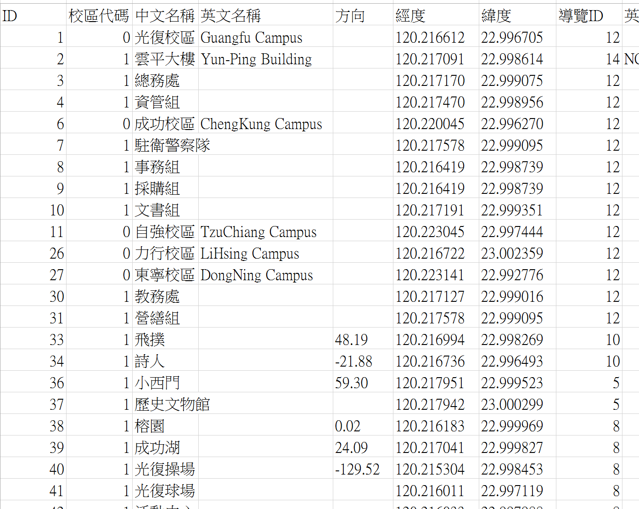
Dataset NCKU Attractions (Latitude and longitude)

Slide 24
Data preprocessing
Latitude and longitude degree convert to kilometer
Km = degree * 110
Person 70 meter per minute
1 unit = 1 minute = degree * 110 * 1000 / 70

Slide 25
t = 0 | 1 | 2 | 3 | 4 | 5 | 6 | 7 | 8 | 9
i = 0 | 0 | 0 | 0 | 0 | 0 | 0 | 0 | 0 | 0
i = 1 | 1 | 1 | 1 | 1 | 1 | 1 | 1 | 1 | 1
i = 2 | 2 | 2 | 2 | 2 | 2 | 2 | 2 | 2 | 2

Slide 26
Result

Slide 27
T = 30
N = 100

Slide 28
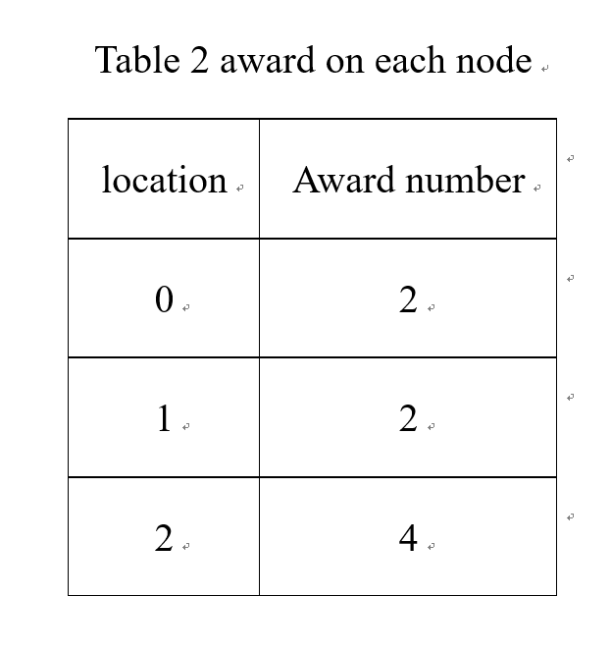
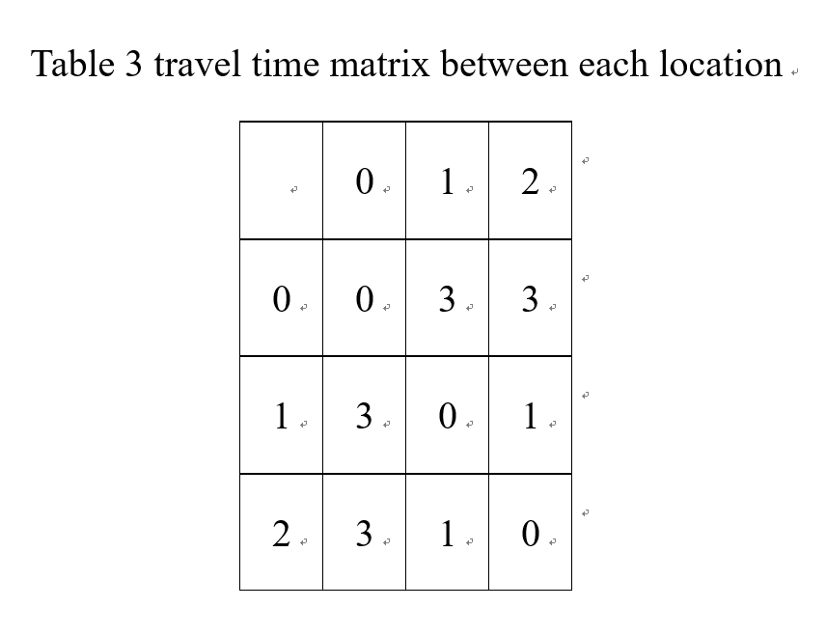

Slide 29
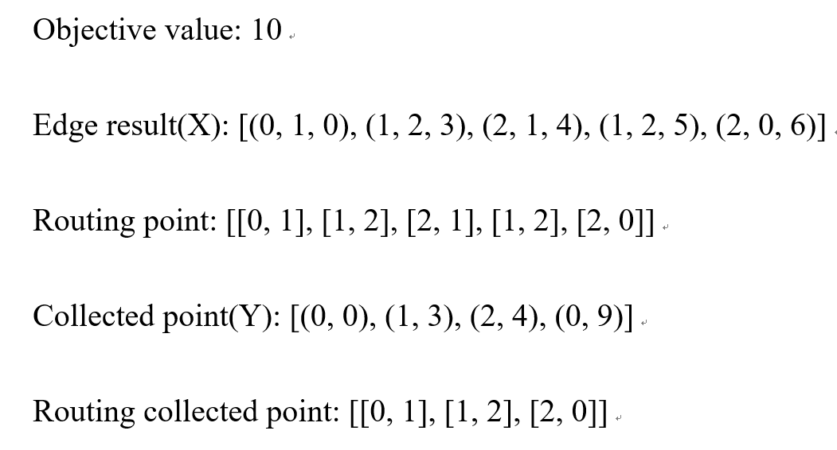

Slide 30
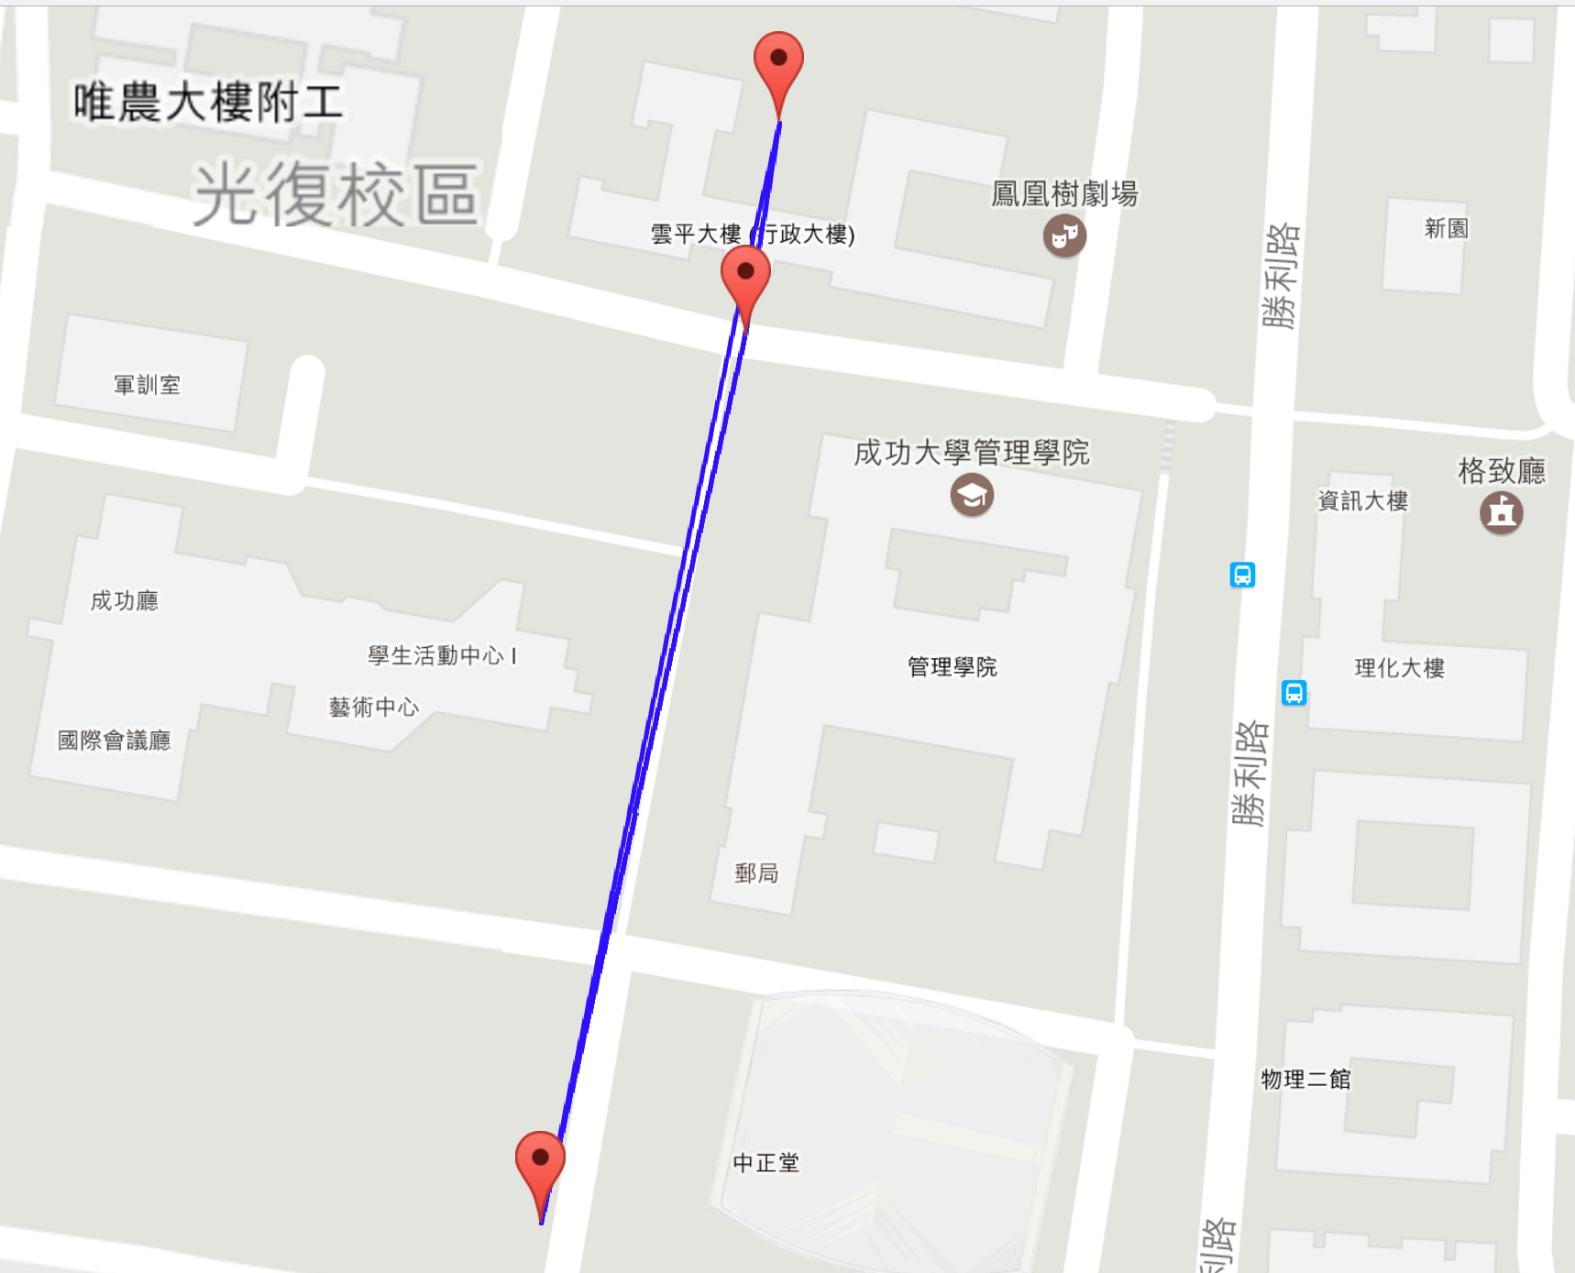

Slide 31
Conclusion
1. unit is too large, can not go through much more location
2. still need other constrained

Slide 32
Reference
http://www.popularmechanics.com/culture/gaming/a21843/traveling-salesman-problem-pokemon-go/
http://www.math.uwaterloo.ca/tsp/poke/index.html
https://github.com/tnlin/PokemonGo-TSP

